Slide 2




Docker Installation on Mac, Windows & Linux Creating Demo Project on Node and Python Creating DockerFile
Creating Docker Image Running Containers Pre-defined Images DockerHub
Docker Volumes and Network Docker Compose

Slide 3



Overview
What is Docker and Why?
What are Containers?
How Container Works?

Slide 4


What is a Docker?

Slide 5


What is a Docker?
Docker is a containerization platform for developing, packaging, shipping, and running applications.
It provides the ability to run an application in an isolated environment called a container.
Makes deployment and development efficient.

Slide 6

Why do we need Docker?

Slide 7


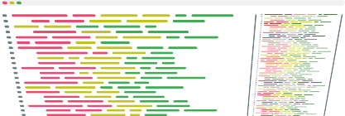


Developer

Slide 8

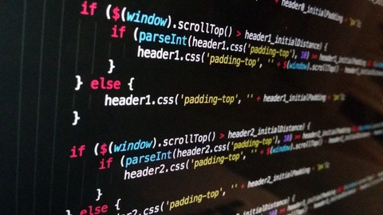

Slide 9



Working Successfully

Slide 10




Let me test on my machine
Working Successfully
Tester

Slide 11





Developer
Tester

Slide 12


Developer
Tester

Slide 13




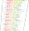


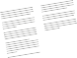





But it is working on my machine
Developer
Tester

Slide 14

What is the solution now?

Slide 15

No worries We have
Docker

Slide 16



Developer

Slide 17

Packaging Docker Image
Developer

Slide 18

Tester
Developer

Slide 19
Tester
Developer

Slide 20
How did it work?

Slide 21
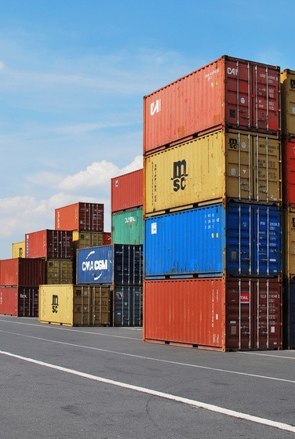

What is a Container?

Slide 22
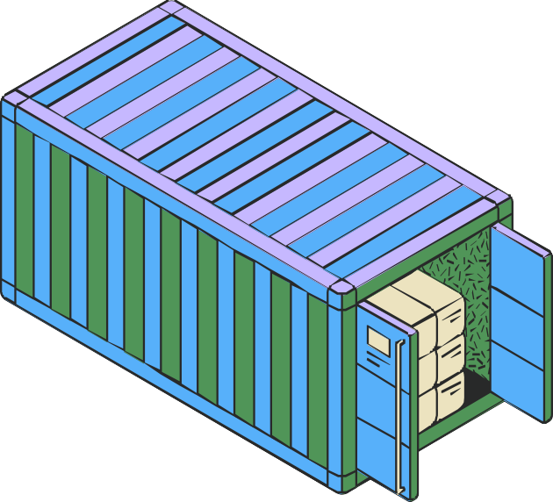

What is a Container?
A way to package an application with all the necessary dependencies and configuration.
It can be easily shared
Makes deployment and development efficient.

Slide 23








Container
APP1
Lib, Dependencies, Tools
Docker Engine
Operating System
Hardware

Slide 24
Container
Container
APP1
APP2
Lib, Dependencies, Tools
Lib, Dependencies, Tools
Docker Engine
Operating System
Hardware

Slide 25

Container
Container
Container
APP1
APP2
APP3
Lib, Dependencies, Tools
Lib, Dependencies, Tools
Lib, Dependencies, Tools
Docker Engine
Operating System
Hardware

Slide 26


App2
App1
V14
V16

Slide 27






















App1
V14
App2
V16
HOST OS
Virtualization

Slide 28
Container
Container
APP1
APP2
V14
V16
Docker Engine
Operating System
Hardware

Slide 29
Docker vs VMs

Slide 30
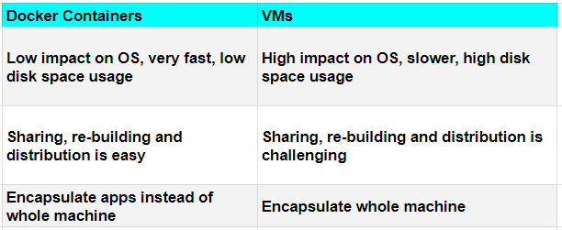

Slide 31
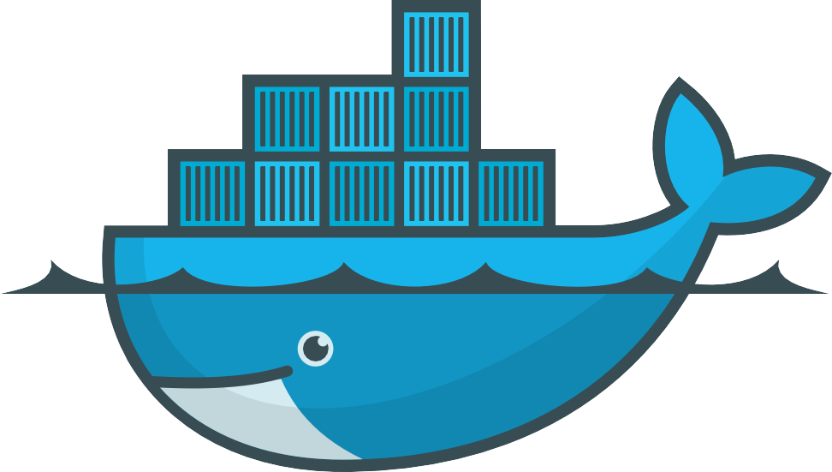

Main components of Docker
DockerFile Docker Image Docker Container Docker Registry

Slide 32
Instance of an Image
It is a simple text file with instructions to build an image.
Container
DockerFile
Image
Container
Single File with all the dep and lib to run the program
Container

Slide 33
Docker Registry
A Docker registry is a central repository for storing and distributing Docker images.

Slide 34
Docker Hub
Or Private Registry
MyAPP v1.0
DockerFile
Image

Slide 35

Docker Hub
Or Private Registry
MyAPP v1.0
DockerFile
Image
MyAPP v1.0

Slide 36
Conclusion:
Docker is a powerful technology that allows developers to create, package, and
deploy applications in containers.
It provides a consistent environment for development, testing, and deployment, and it's compatible with any platform that supports Docker.
By using Docker, developers can focus on building great applications instead of worrying about infrastructure and compatibility issues.

Slide 37
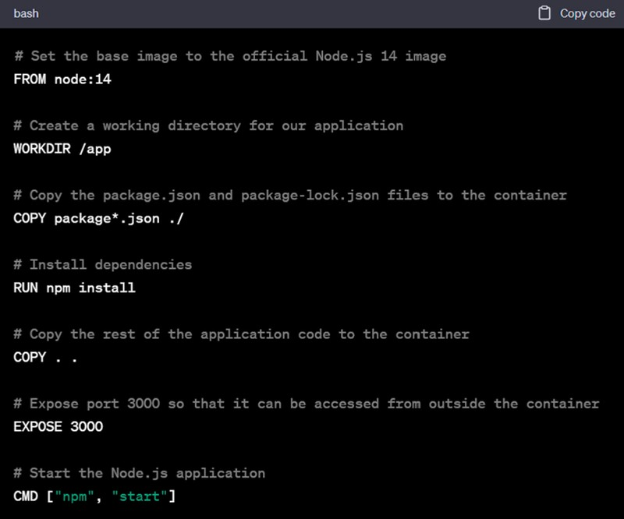


Slide 38

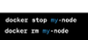

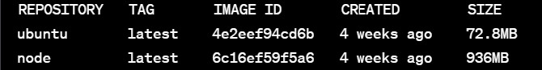

Slide 39
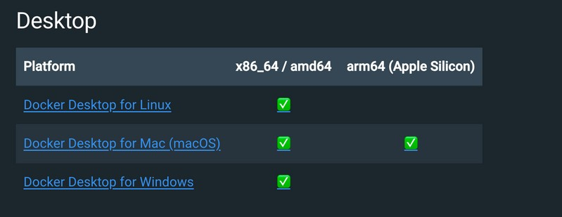
Install Docker Engine

Slide 40


Docker Volumes
Container
myapp.py
servers.txt
servers.txt

Slide 41






Docker Volumes (bind mount)
Container
servers.txt
myapp.py
servers.txt

Slide 42
Communication From/To Containers

Slide 43







Container
myapp.py
servers.txt

Slide 44


Container
myapp.py
servers.txt
Local Machine

Slide 45

Container
Container
myapp.py
MySQL

Slide 46
Docker Network

Slide 47
Network: my-net
Container
Container
myapp.py
MySQL
--network my-net

Slide 48
Docker Compose
Configuration file to manage multiple containers running on same machine..

Slide 49
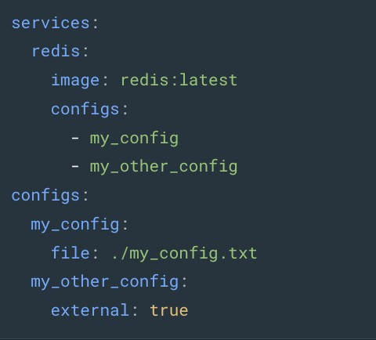

Slide 50
Please Like & SUBSCRIBE
Thannnkkk
youuu!!!

